Slide 1
4.5 Distributed Mutual Exclusion
Ranjitha Shivarudraiah

Slide 2
Agenda
What is Mutual exclusion ?
Mutual exclusion in Distributed operating systems.
Mutual Exclusion algorithms
  Centralized Algorithms
  Distributed algorithms
      Contention based solutions
      Token based (Controlled) solutions
Research
Summary and Conclusions

Slide 3
What is Mutual exclusion?
Mutual exclusion : makes sure that concurrent process access shared resources or data in a serialized way.
If a process , say P_{i} , is executing in its critical section, then no other processes can be executing in their critical sections
Example: updating a DB or sending control signals to an IO device

Slide 4
What is Mutual exclusion ?
Mutual exclusion in Distributed operating systems.
Mutual Exclusion algorithms
  Centralized Algorithms
  Distributed algorithms
      Contention based solutions
      Control based solutions
Research
Summary and Conclusions

Slide 5
Mutual exclusion in DOS
There are three major communication scenarios:
1. One-way Communication usually do not need synchronization.
Client/server communication is for multiple clients making service request to a shared server. If co-ordination is required among the clients, it is handled by the server and there is no explicit interaction among client process.

Slide 6
Mutual exclusion in Distributed operating systems Contd…
3. Interprocess communication:
-> not limited to making service requests.
-> processes need to exchange information to reach some conclusion about the system or some agreement among the cooperating processes.
These activities require peer communication; there is no shared object or centralized controller.
Notes:
1. Mutual Exclusion - If process P_{i} is executing in its critical section, then no other processes can be executing in their critical sections
2. Progress - If no process is executing in its critical section and there exist some processes that wish to enter their critical section, then the selection of the processes that will enter the critical section next cannot be postponed indefinitely
3. Bounded Waiting - A bound must exist on the number of times that other processes are allowed to enter their critical sections after a process has made a request to enter its critical section and before that request is granted

Slide 7
What is Mutual exclusion ?
Mutual exclusion in Distributed operating systems.
Mutual Exclusion algorithms
  Centralized Algorithms
  Distributed algorithms
      Contention based solutions
      Control based solutions
Research
Summary and Conclusions

Slide 8
Mutual Exclusion Algorithms
Mutual Exclusion
algorithms
Centralized
algorithms
Distributed
Algorithms
Contention Based
Algorithms
Controlled
Algorithms
(Token based algorithms)
Timestamp prioritized schemes
Tree Structure
Voting schemes
Broadcast Structure
Ring Structure

Slide 9
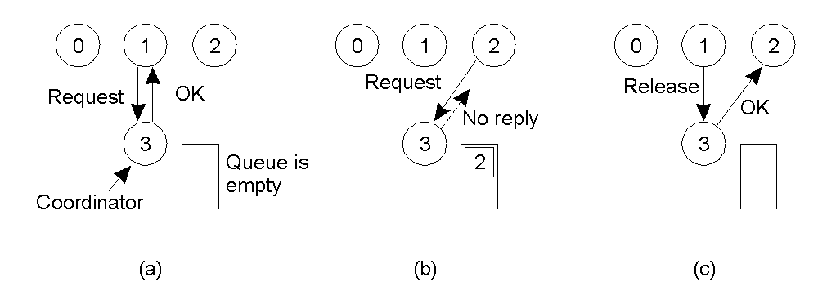
Centralized Algorithm
a) . Process 1 asks the coordinator for permission to enter a critical region. Permission is granted
b) . Process 2 then asks permission to enter the same critical region. The coordinator does not reply.
c) . When process 1 exits the critical region, it tells the coordinator, which then replies to 2 [2]

Slide 10
Centralized algorithms contd..
Advantages
  Fair algorithm, grants in the order of requests
  The scheme is easy to implement
  Scheme can be used for general resource allocation
  Critical Question: When there is no reply, does this mean that the coordinator is “dead” or just busy?
Shortcomings
  Single point of failure. No fault tolerance
  Confusion between No-reply and permission denied
  Performance bottleneck of single coordinator in a large system

Slide 11
Distributed Algorithms
Distributed Mutual Exclusion
  Contention-based Mutual Exclusion
    Timestamp Prioritized Schemes
    Voting Schemes
  Token-based Mutual Exclusion
    Ring Structure
    Tree Structure
    Broadcast Structure

Slide 12
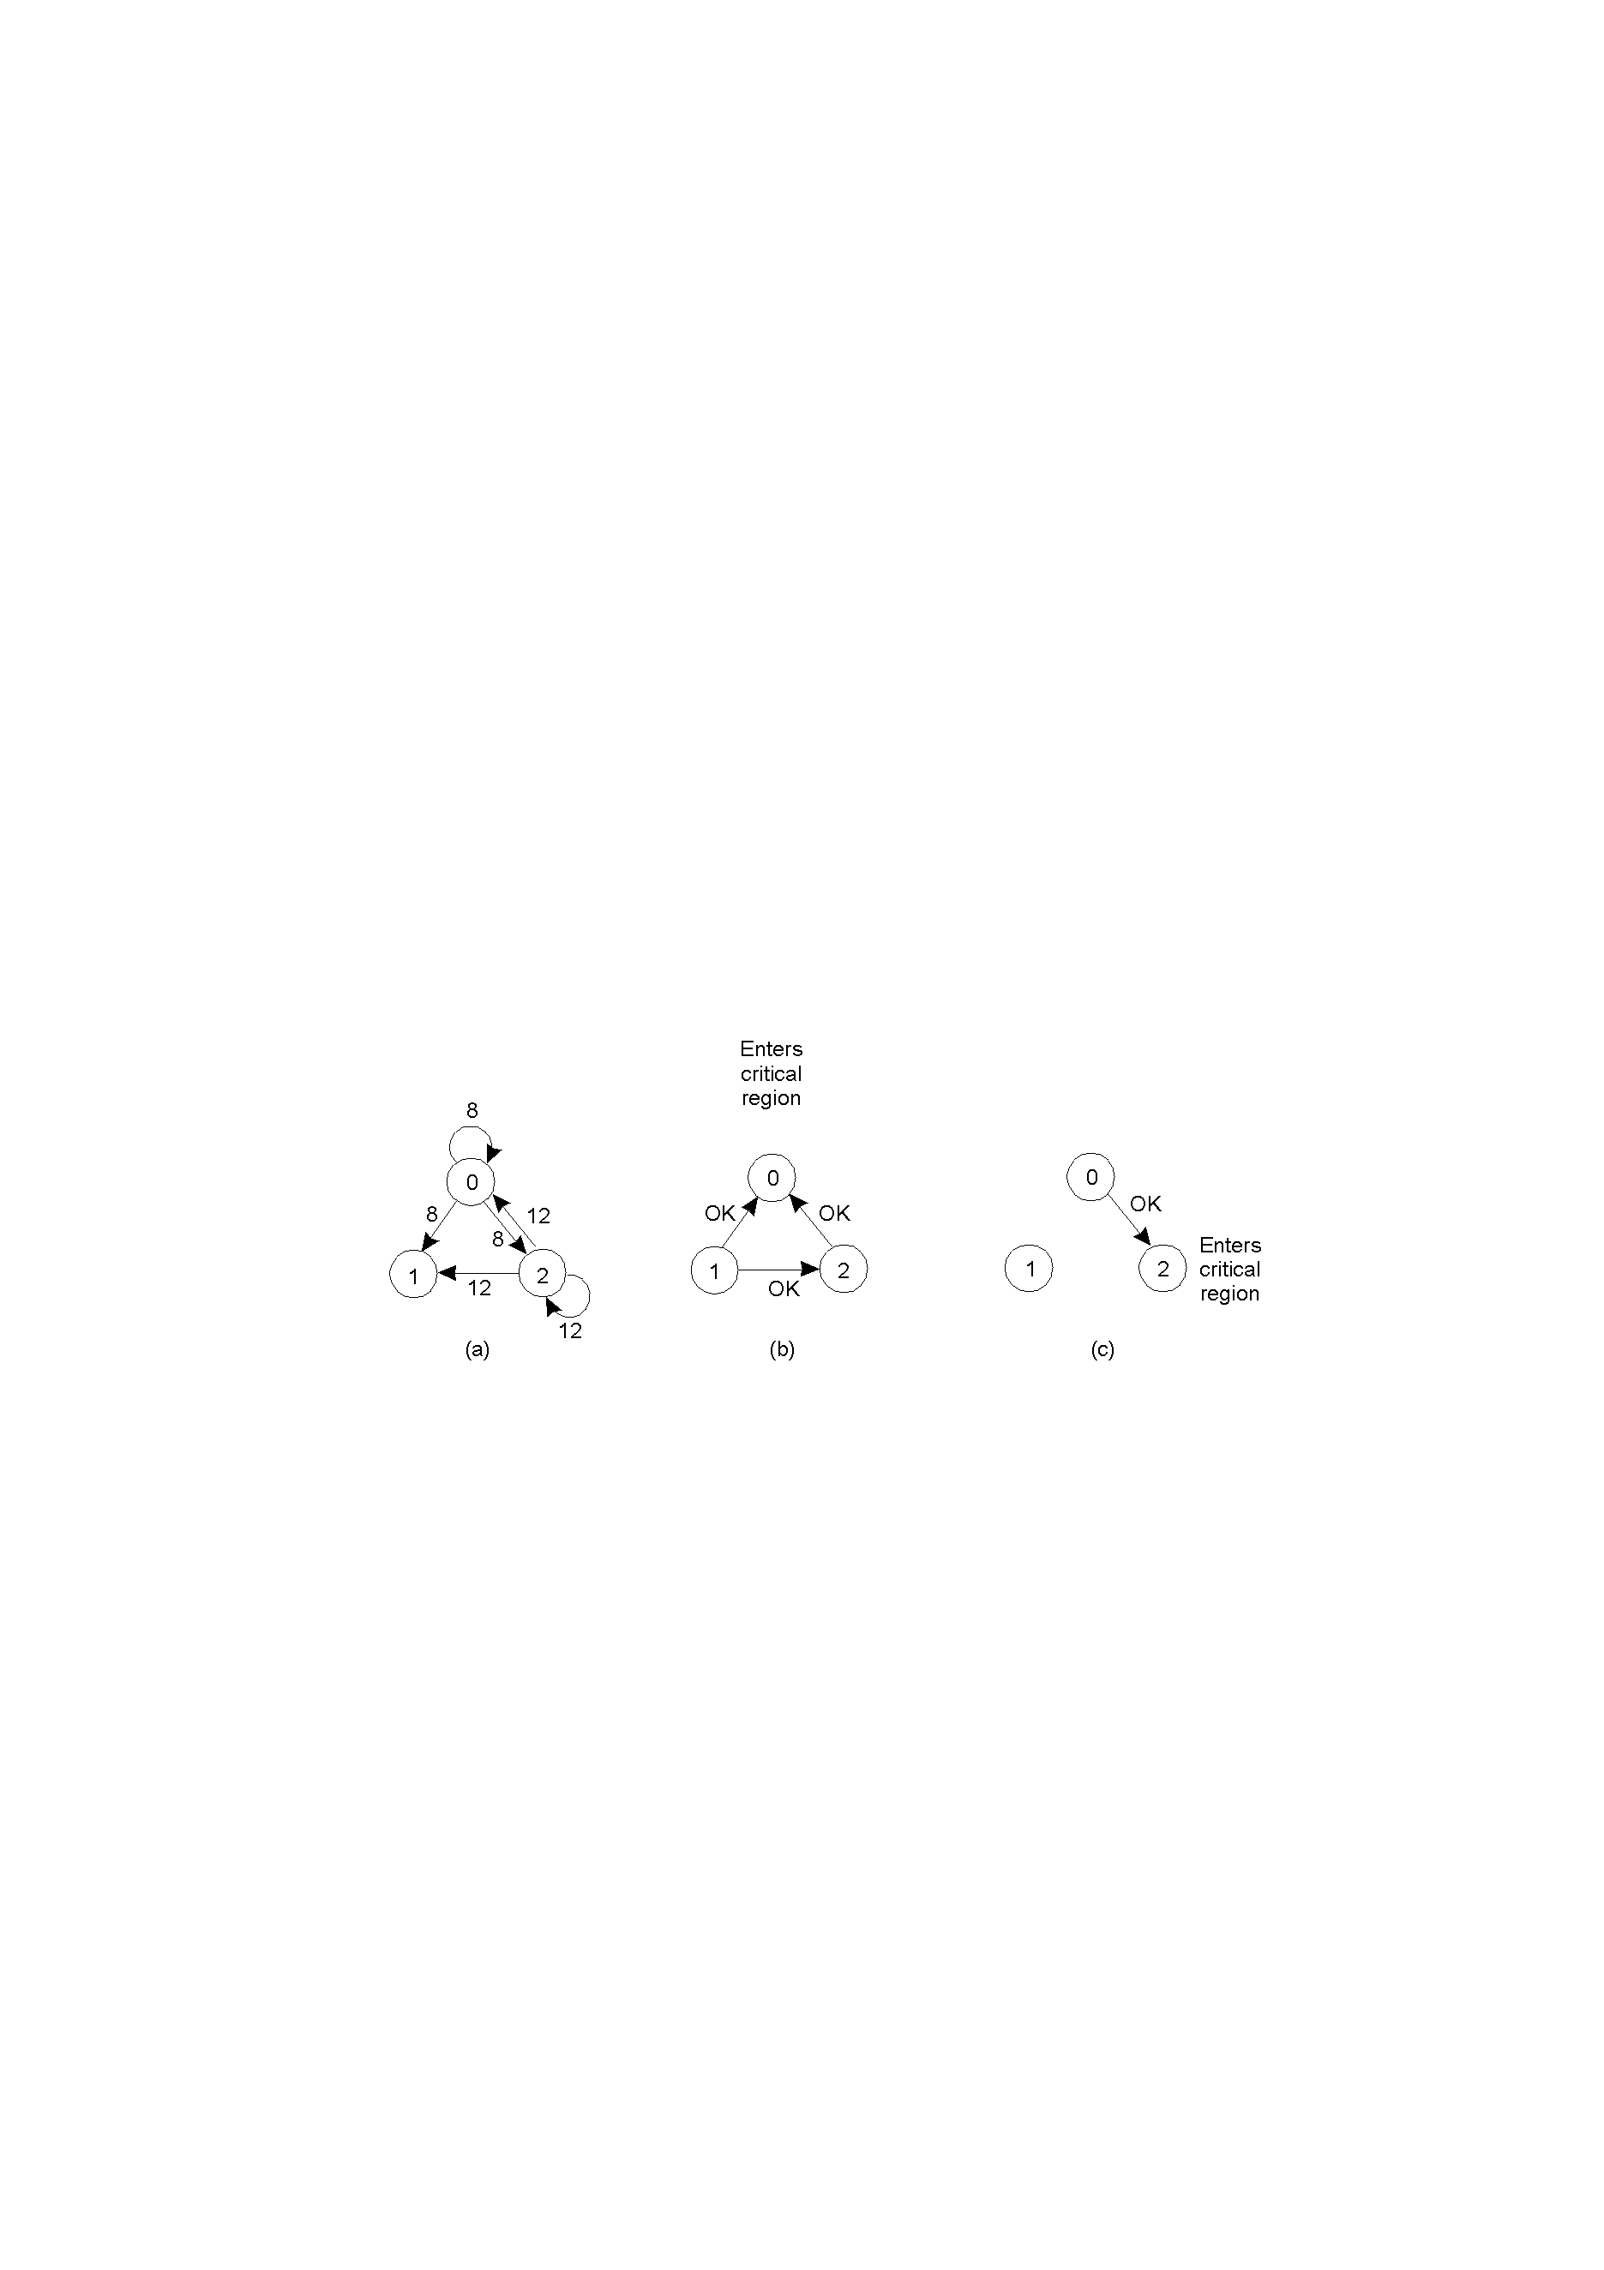
Timestamp Prioritized Schemes
A> Two processes want to enter the same critical region .
B> Process 0 has the lowest timestamp, so it wins.
C> When process 0 is done, it sends an OK also, so 2 can now enter the critical region[2]

Slide 13
Timestamp Prioritized Schemes
Lamport’s “logical clock” is used to generate timestamps. These are the general properties for the method:
  The general mechanism is that a process P[i] has to send a REQUEST ( with ID and time stamp ) to all other processes.
  When a process P[j] receives such a request, it sends a REPLY back.
When responses are received from all processes, then P[i] can enter its Critical Section.
  When P[i] exits its critical section, the process sends RELEASE messages to all its deferred requests.
  The total message count is 3*(N-1), where N is the number of cooperating processes.
Notes:
The above scheme achieves ME + no Starvation( with the implementation of the timeout ) + progress.

Slide 14
Ricart and Agrawala algorithm
Requesting Site:
  A requesting site Pi sends a message request(ts,i) to all sites.
Receiving Site:
  Upon reception of a request(ts,i) message, the receiving site Pj will immediately send a timestamped reply(ts,j) message if and only if:
    Pj is not requesting or executing the critical section OR
    Pj is requesting the critical section but sent a request with a higher timestamp than the timestamp of Pi
  Otherwise, Pj will defer the reply message.

Slide 15
Ricart and Agrawala algorithm Contd..
Performance
Number of network messages; 2*(N-1)
Synchronization Delays: One message propagation delay
Mutual exclusion: Site Pi enters its critical section only after receiving all reply messages.
Progress: Upon exiting the critical section, Pi sends all deferred reply messages.

Slide 16
Ricart and Agrawala algorithm Contd..
Disadvantage of Ricart and Agarwala Algorithm:
Failure of a node – May result in starvation.
Solution: This problem can be solved by detecting failure of nodes after some timeout.[1]

Slide 17
Voting schemes
Requestor:
Send a request to all other processes.
Enter critical section once REPLY from a majority is received
Broadcast RELEASE upon exit from the critical section.
Other processes:
REPLY to a request if no REPLY has been sent. Otherwise, hold the request in a queue.
If a REPLY has been sent, do not send another REPLY till the RELEASE is received. [1]
Possibility of a Deadlock
Consider a situation when each candidate wins one-third of votes…..

Slide 18
Voting scheme ,improvement
One of the possible solutions would be :
Any process retrieves its REPLY message by sending an INQUIRY if the requestor is not currently executing in the critical section. The Requestor has to return the vote through a RELINQUISH message.
Notes:
Deadlock possible if each candidate wins a third of votes.

Slide 19
Token-based Mutual Exclusion
Although contention-based distributed mutual exclusion algorithms can have attractive properties, their messaging overhead is high. An alternative to contention-based algorithms is to use an explicit control token, possession of which grants access to the critical section.[1]

Slide 20
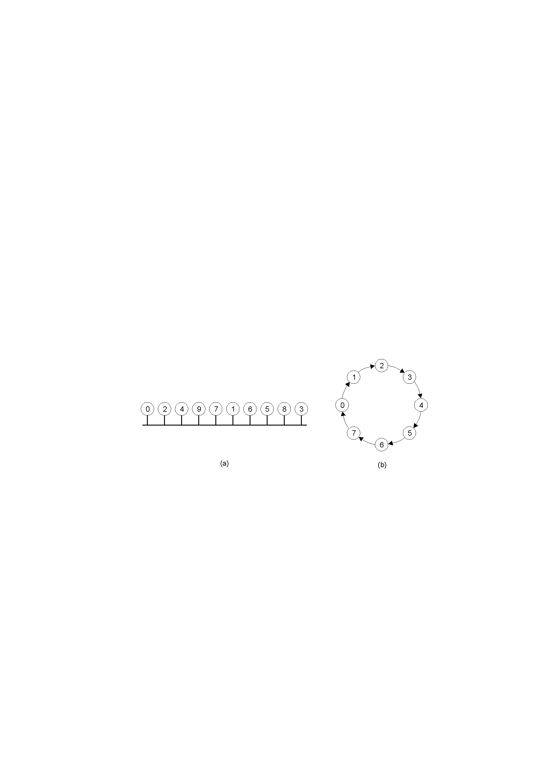
Ring Structure

Slide 21
Ring structure contd..
In software, a logical ring is constructed in which each process is assigned a position in the ring, as shown in the previous Fig.
The ring positions may be allocated in numerical order of network addresses or some other means.
It does not matter what the ordering is. All that matters is that each process knows who is next in line after itself.[1]

Slide 22
Ring structure contd..
simple, deadlock-free, fair.
The token circulates even in the absence of any request (unnecessary traffic).
Long path (O(N)) – the wait for token may be high.
Works out when the traffic load is high.
Token can also carry state information.

Slide 23
Tree structure( Raymond’s Algorithm)
Each process explicitly requests for a token and the token is moved only when no process if the process knows of a pending request.
Notes:
Node 4 requests first, node 3 follows.
Token migrates from node 1(root) to node 4( via 2 and 3).
The node 3 passes the request to node 4 and also request to enter the CS next. This request establishes a link between 3 and 4.
No deadlock possible coz no cycle in a tree.

Slide 24
Tree structure
The root of the tree holds the token to start off.
The processes are organized in a logical tree structure, each node pointing to its parent.
Further, each node maintains a FIFO list of token requesting neighbors.
Each node has a variable Tokenholder initialized to false for everybody except for the first token holder (token generator).

Slide 25
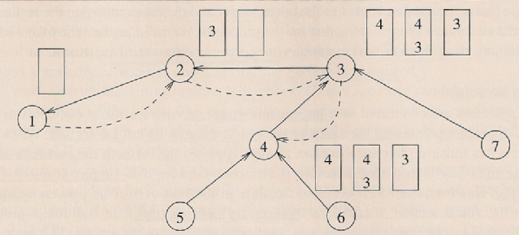
Tree Structured token passing

Slide 26
Tree Structure contd…
The processes are organized in a logical tree structure, each node pointing to its parent. Further, each node maintains a FIFO list of token requesting neighbors. Each node has a variable Tokenholder initialized to false for everybody except for the first token holder (token generator).
Entry Condition
If not Tokenholder
If the request queue empty
request token from parent;
put itself in request queue;
block self until Tokenholder is true;

Slide 27
Tree Structure contd…
Exit condition:
If the request queue is not empty parent = dequeue(request queue); send token to parent; set Tokenholder to false; if the request queue is still not empty, request token from parent;

Slide 28
Tree Structure contd…
Upon receipt of token
Parent = Dequeue(request queue); if self is the parent
Tokenholder = true
else
send token to the parent; if the queue is not empty request token from parent;

Slide 29
Broadcast structure( Suzuki/ Kasami’s algorithm).
Imposing a logical topology like a ring or tree is efficient but also complex because the topology has to be implemented and maintained.
Group communication:
  Unaware of the topology
  More transparent and desirable.

Slide 30
Broadcast structure
Data Structure:
The token contains
Token vector T(.) – number of completions of the critical section for every process.
Request queue Q(.) – queue of requesting processes.
Every process (i) maintains the following
seq_no – how many times i requested critical section.
Si(.) – the highest sequence number from every process i heard of.

Slide 31
Broadcast structure contd…
Entry condition:
Broadcast a REQUEST message stamped with seq_no.
Enter critical section after receiving token
Exit Condition:
Update the token vector T by setting T(i) to S_{i}(i).
If process k is not in request queue Q and there are pending requests from k (S_{i}(k)>T(k)), append process k to Q.
If Q is non-empty, remove the first entry from Q and send the token to the process indicated by the top entry.

Slide 32
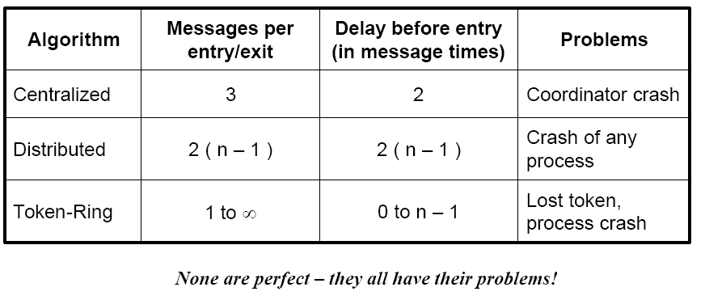
Comparison of the Mutual exclusion algorithms

Slide 33
What is Mutual exclusion ?
Mutual exclusion in Distributed operating systems.
Mutual Exclusion algorithms
  Centralized Algorithms
  Distributed algorithms
      Contention based solutions
Control based solutions
Research
Summary and Conclusions

Slide 34
Proposed Distributed Mutual Exclusion Algorithms
A fair decentralized mutual exclusion algorithm for distributed systems is proposed in which processes communicate by asynchronous message passing. The algorithm requires between (N-1) and 2(N-1) messages per critical section access, where N is the number of processes in the system.[3]
The Sigma algorithm that solves fault-tolerant mutual exclusion problem in dynamic systems where the set of processes may be large and change dynamically, processes may crash, and the recovery or replacement of crashed processes may lose all state information (memory losses) is introduced. [4]

Slide 35
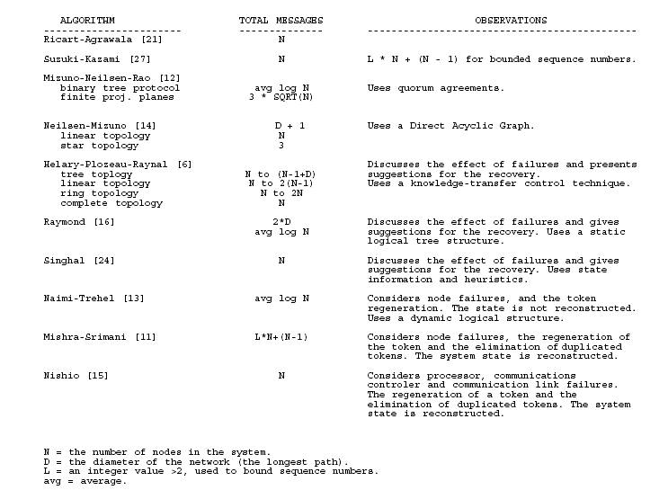
Comparison of token based algorithms[6]

Slide 36
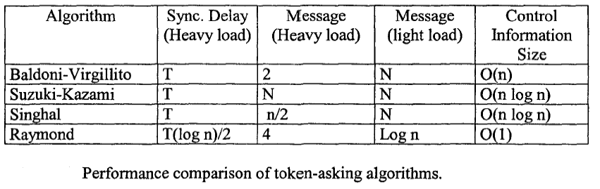
Distributed mutual exclusion algorithms for Ad-Hoc Networks[7]

Slide 37
Summary
The concept of Mutual exclusion for Distributed operating systems introduced.
Mutual Exclusion algorithms studied.
  Centralized Algorithms
  Distributed algorithms
      Contention based solutions
      Token based (Controlled) solutions
Overview of the ongoing research.

Slide 38
References
[1] Distributed operating systems & Algorithms, By Randy chow, Theodore Johnson. 1998
[2] Distributed Operating sytems – Andrew S Tanenbaum
[3]A Fair Distributed Mutual Exclusion Algorithm, Sandeep Lodha, Ajay Kshemkalyani
(IEEE Transactions on Parallel and Distributed Systems archive )
[4] Sigma: a fault-tolerant mutual exclusion algorithm in dynamic distributed systems subject to process crashes and memory losses,Wei Chen; Shiding Lin; Qiao Lian; Zheng Zhang(This paper appears in: Dependable Computing, 2005. Proceedings. 11th Pacific Rim International Symposium )
[5]Simulations:
http://www.risc.uni-linz.ac.at/software/daj/snapshot/
[6] ASurveyofDistributedMutual ExclusionAlgorithms By MartinG.Velazquez.
[7] Distributed Mutual Exclusion Algorithms In Mobile
Ad Hoc Networks: An overview*
M. Bench~fl"ba 1, A. BouabdaUah 2, N. Badache 1 and M. Ahrned-Nacer 1(ACM publications)

Slide 39


